Slide 1
Pipavav Railway Corporation Ltd.
A PPP of Ministry of Railways & Gujarat Pipavav port limited

Slide 2
Contents
Background
Status of the Company
Project location
PRCL project details
PRCL’ s Agreements

Slide 3
More than 2 decades of growth
> Parliament of India sanctioned Broad Gauge (BG) rail line between Surendranagar and Pipavav in the state of Gujarat.
> Paucity of funds faced by Indian Railways (IR) delayed implementation of BG conversion
> Gujarat Pipavav Port Limited (GPPL) approached Ministry of Railways (MOR) for providing last-mile rail connectivity and funding the Project as a JV Partner
> Both GPPL and MoR agreed to form a Special Purpose Vehicle (i.e. PRCL) to construct, operate and maintain broad gauge rail connectivity from Surendranagar to Pipavav Port
> PRCL is formed with approval of the Cabinet Committee on Economic Affairs
Year 1996
Year 1999
Year 2000

Slide 4
PRCL - A Joint Venture (JV) Company
First JV on PPP (Public Private Partnership) model of Indian Railways
Public - Ministry of Railways (MoR) and Private - Gujarat Pipavav Port Limited (GPPL) Participation with 50 - 50 equity.
Defined Objectives - To construct, Operate and Maintain BG rail line to serve Port of Pipavav (APM Terminals, Pipavav).
Board of Directors with 50 – 50 representation from MoR and GPPL to manage the Company.
PRCL is not a PSU.

Slide 5
Project Location

Slide 6
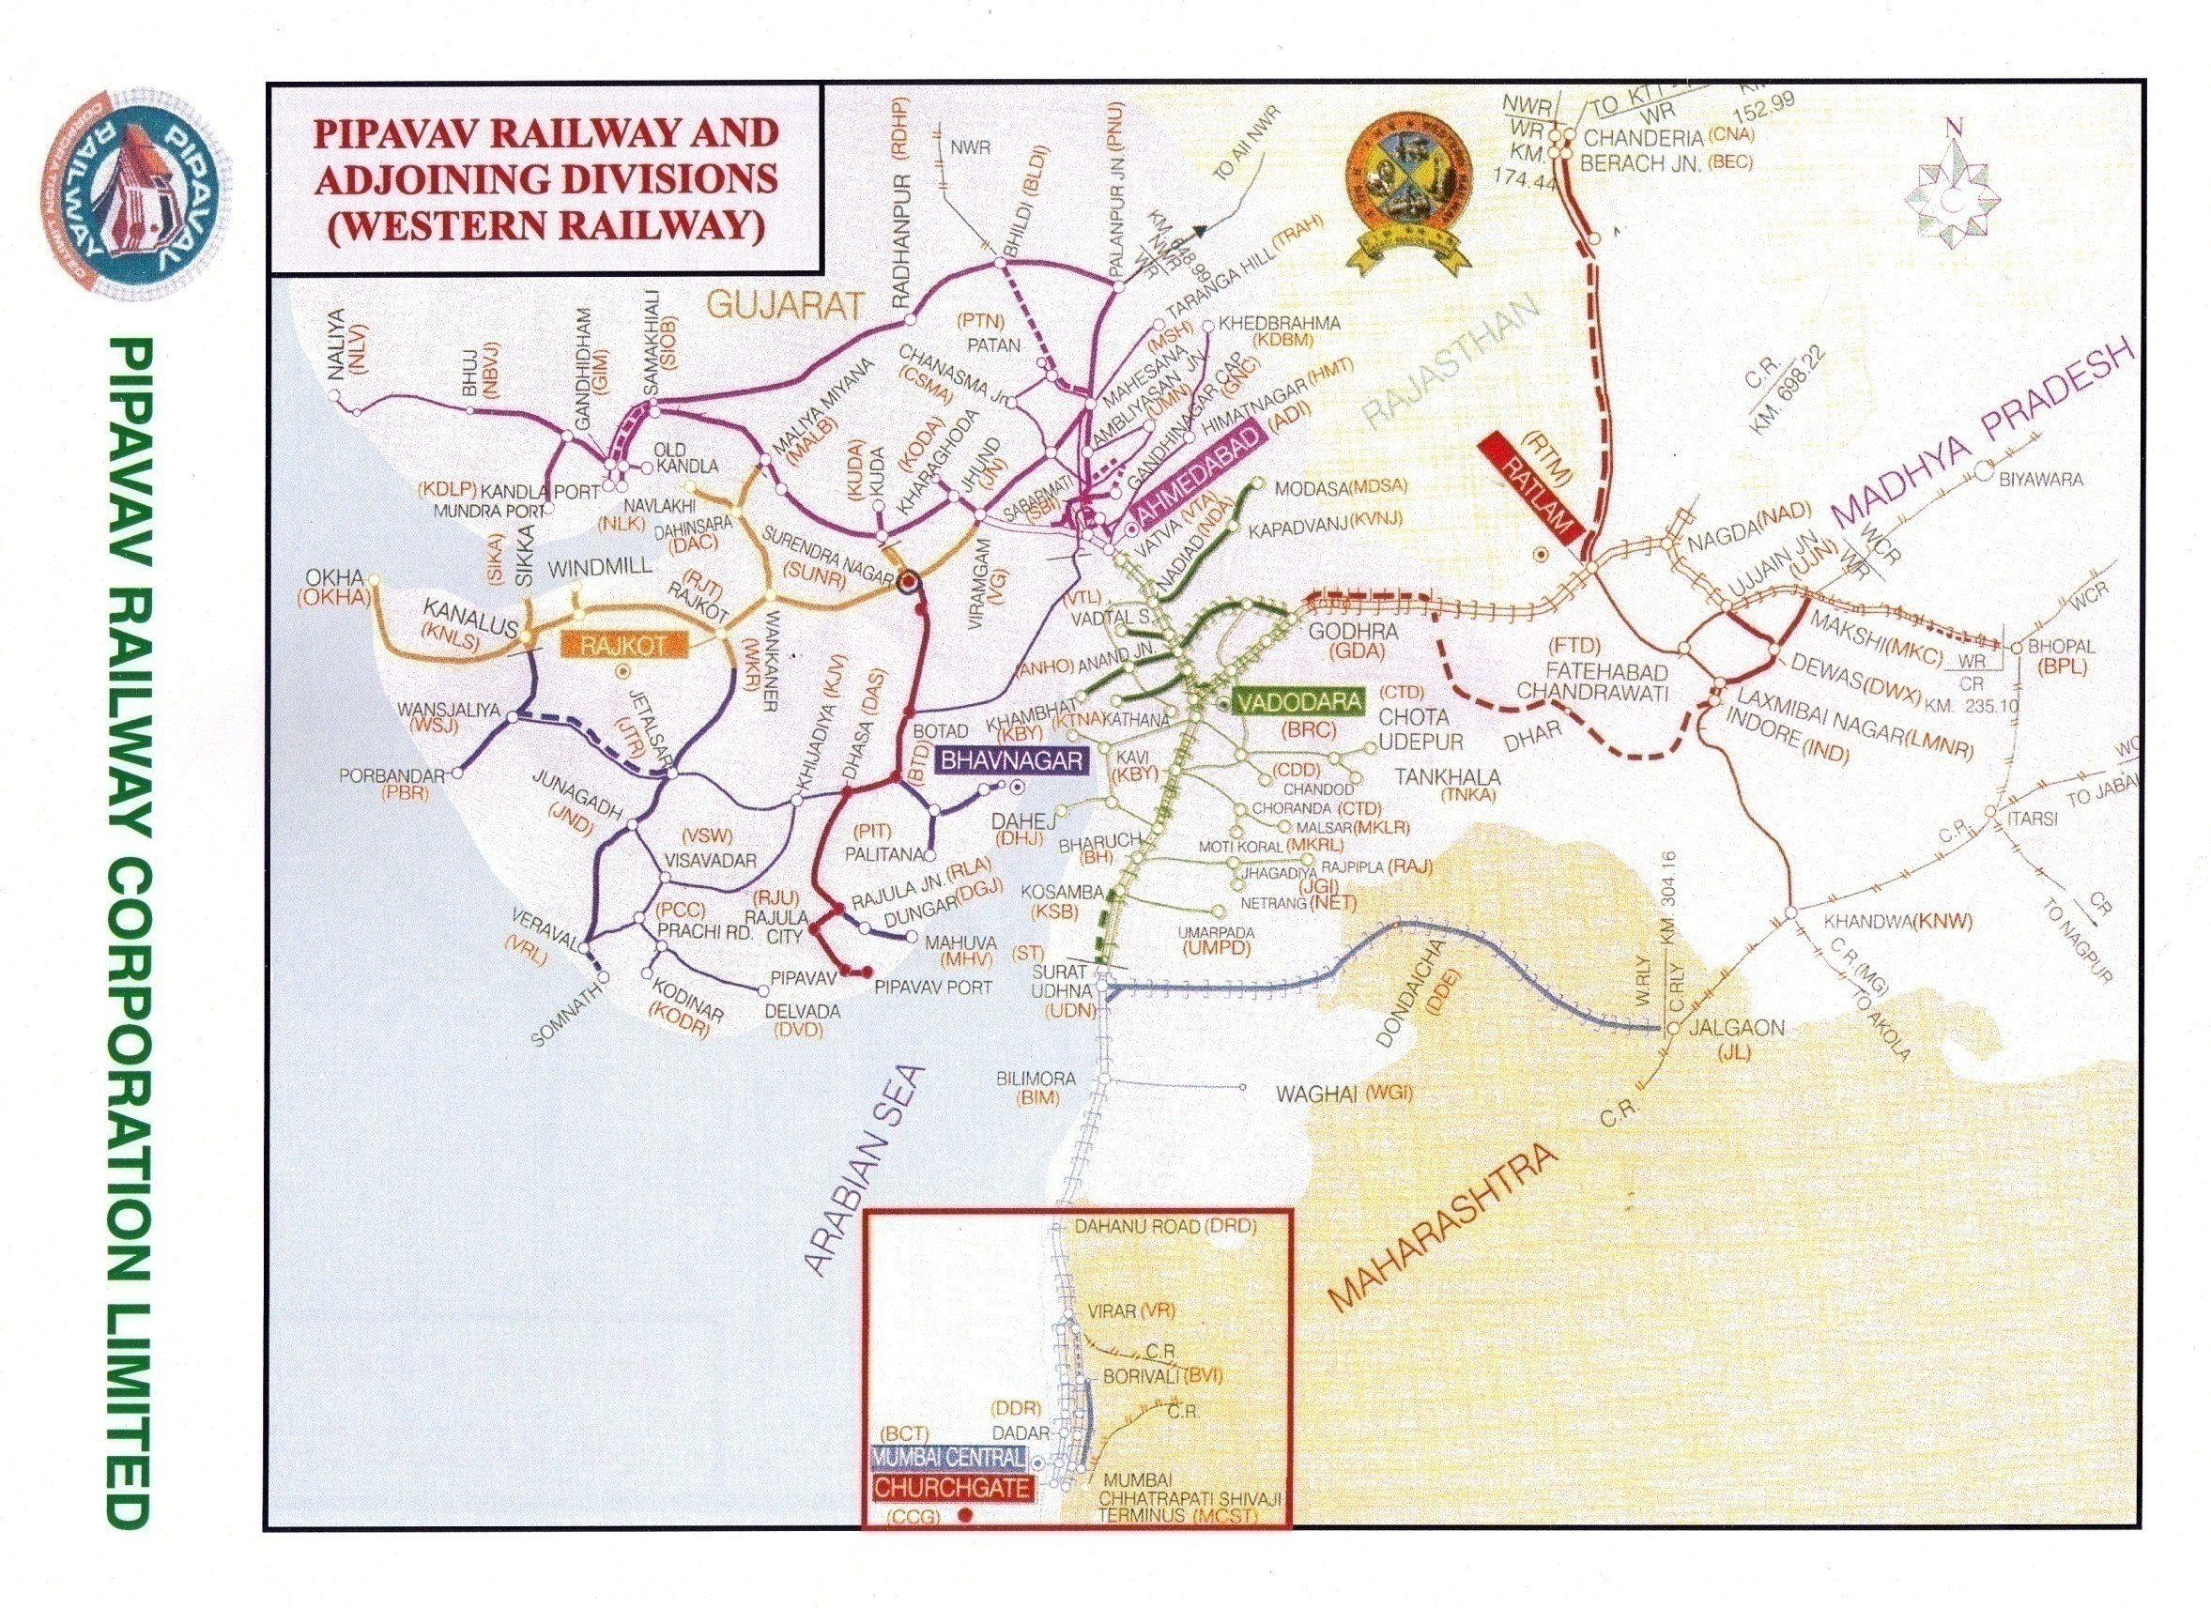

Slide 7
PRCL- Project Details
Located in Saurashtra region of Gujarat State.
About 270 Kms. rail line connecting Surendranagar– Pipavav Port.
Estimated Project cost – Rs. 373 crores.
Funding of Project : Equity- Rs.196 crores and Debt-Rs.177 crore.
Construction of rail line by WR. Time taken – 1 year.
Project completed in March 2003.
All construction material procured and supplied by PRCL.
Line is fit both for passenger and goods train operation.

Slide 8
PRCL Agreements
MOU between Ministry of Railways (MOR) & Gujarat Pipavav Port Limited (GPPL) – January, 2000.
Shareholder’s Agreement between MOR and GPPL – March, 2001.
Concession & Lease Agreement between MOR and PRCL – June, 2001.
Construction Agreement between PRCL and WR – March, 2002.
Transportation & Traffic Guarantee Agreement among PRCL, GPPL and WR – January, 2003.
Operation & Maintenance Agreement between PRCL and WR – February, 2003.
Siding Agreement between GPPL and PRCL to be renewed every year (last renewed for a period up to 17th August, 2021).

Slide 9
Memorandum of Understanding
MOR and GPPL to set up a Special Purpose Vehicle (SPV) - Joint Venture of 50 – 50 equity contribution.
SPV - Non Government Railway Administration under the Railways Act, 1989.
SPV to undertake implementation of the Broad Gauge rail link project.
Nominee Directors on PRCL Board from MOR & GPPL and Chairmanship of the Company remains with Indian Railways.
All assets are made available on lease to the SPV at a pre -specified rental at historical cost.

Slide 10
Shareholder’s Agreement
MOR & GPPL to contribute Rs.98 crores each towards equity.
GPPL guarantees to PRCL a minimum annual aggregate quantity of Freight traffic to ensure viability of the Project.
WR guarantees to PRCL to provide sufficient Rolling Stock for evacuation of cargo from Port within a maximum prescribed time of 240 hours.
Board of Directors are responsible for management, control and supervision of SPV.

Slide 11
Concession Agreement
MOR to lease all the project assets namely land, buildings, Permanent way, signalling equipment, etc. to PRCL for a period of 33 years (Concession Period).
PRCL is entitled to the rights, obligation & duties of a Railway Administration under the Railways Act 1989.
PRCL has right to construct and maintain the infrastructure and operate freight train services on the Project Railway and right to develop additional facilities for the purpose (freight services).
PRCL to have right to commercial exploitation of assets, i.e. land, building, etc.

Slide 12
Concession Agreement
MOR has right to collect apportioned freight revenue from train operations on the Project Railway,
PRCL has right to receive share in freight from MOR for running of the freight trains on PRCL line.
PRCL to bear all costs of Operation & Maintenance for purpose of freight train services on this line.
Cost of infrastructure for passenger services is not to be borne by PRCL.
MOR, at their cost, have right to run equivalent number of passenger services as on Meter Gauge (before the gauge conversion project was taken in hand by PRCL) without any access charge to PRCL. However, new service will require prior permission from PRCL.

Slide 13
TRANSPORTATION AND TRAFFIC GUARANTEE AGREEMENT
GPPL guarantees to PRCL of minimum quantity of cargo i.e.
1 million ton for the 1st year (2003-04) of operations,
2 million tonne in the 2nd year, and
3 million tonne in the 3rd year onwards.
Shortfall in traffic: GPPL will pay apportioned freight taking the average prevailing rate of freight per ton km on IR.
Western Railway guarantees to PRCL supply of sufficient rolling Stock for evacuation of cargo from port (within a maximum period of 240 Hrs).
For shortfall in wagon supply, WR is to give credit to PRCL of freight tonnage that would have accrued to PRCL had wagons been supplied in time.

Slide 14
Operation & Maintenance Agreement
PRCL to pay wagon and loco hire charges without the element of interest.
Mechanized maintenance of railway assets on the lines of KONKAN Railway.
O&M costs consists of -
Cost of Railway staff posted on PRCL (Only for freight operation).
Cost of material required for maintenance of assets.
Variable cost of train operation such as wagon / loco hire charge, cost of crew, fuel etc.
Direct & indirect charges, not covered under above, such as pensionary benefits, medical, RPF, etc.

Slide 15
THANK YOU

